Slide 1
Welcome!
Sunday
Bible Study 9:30 AM
Worship 10:30 AM
Wednesday
Bible Class 7:00 PM
www.SunsetchurchofChrist.net

Slide 2
John 8:21-30
Jesus reveals His goal
Belief in Jesus
Speaking from the Father

Slide 3
Welcome!
Sunday
Bible Study 9:30 AM
Worship 10:30 AM
Wednesday
Bible Class 7:00 PM
www.SunsetchurchofChrist.net

Slide 4
Opening Prayer | Gregor Hinckley
Song – 3 | George Watkins
Scripture Reading | Ryan Sollars
Song – 513 | George Watkins
Song – 172 | George Watkins
Lord’s Supper | Ryan Sollars / Michael Hetzer
Song – 489 | George Watkins
Collection | Ryan Sollars / Michael Hetzer
Song – 416 | George Watkins
Lesson | Brian Haines
Song –524 | George Watkins
Closing | Lamar McDonald

Slide 5
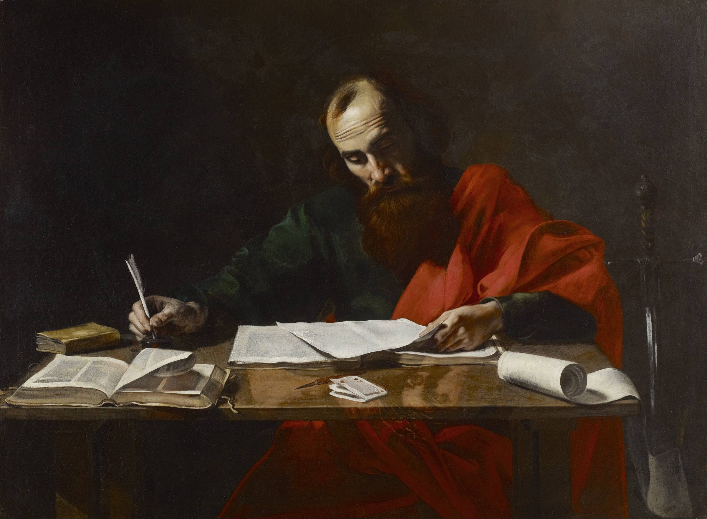
Paul’s Corinthian Advice
1 Corinthians 16
Concerning the Collection
Notes:
Begin reading at vs. 15

Slide 6
The Church and Money
Aiding Christians in need
Acts 2,4-5, 1 Timothy 5

Slide 7
The Church and Money
Aiding Christians in need
Aiding churches with Christians in need
1 Corinthians 16, Acts 11

Slide 8
The Church and Money
Aiding Christians in need
Aiding churches with Christians in need
Supporting those who labor for the Gospel
1 Corinthians 9, Galatians 6

Slide 9
The Church and Money
Aiding Christians in need
Aiding churches with Christians in need
Supporting those who labor for the Gospel
Supporting widows in the church
Acts 6, 1 Timothy 5

Slide 10
The Church and Money
Aiding Christians in need
Aiding churches with Christians in need
Supporting those who labor for the Gospel
Supporting widows in the church
Inference – all works of the church

Slide 11
The Church and Money
What was the plan to finance these works?
Law of Moses: the Tithe (1/10)?
Designed for twelve tribes
Taxation
Law of Christ: Spiritual
What would a spiritual counter be?

Slide 12
The Collection
Now concerning the collection for the saints, as I have given orders to the churches of Galatia, so you must do also: On the first day of the week let each one of you lay something aside, storing up as he may prosper, that there be no collections when I come. 1 Corinthians 16:1-2

Slide 13
The Collection
Now concerning the collection for the saints, as I have given orders to the churches of Galatia, so you must do also: On the first day of the week let each one of you lay something aside, storing up as he may prosper, that there be no collections when I come. 1 Corinthians 16:1-2
A collection of money meant to cover the needs of Christians. Since there is no other collection mentioned, it is inferred that this is for all of the financial needs of the church

Slide 14
The Collection
Now concerning the collection for the saints, as I have given orders to the churches of Galatia, so you must do also: On the first day of the week let each one of you lay something aside, storing up as he may prosper, that there be no collections when I come. 1 Corinthians 16:1-2
The command for this collection is universal, given to all churches

Slide 15
The Collection
Now concerning the collection for the saints, as I have given orders to the churches of Galatia, so you must do also: On the first day of the week let each one of you lay something aside, storing up as he may prosper, that there be no collections when I come. 1 Corinthians 16:1-2
The time that is authorized for this is the first day of the week. It seems to be attached to the assembly of worship

Slide 16
The Collection
Now concerning the collection for the saints, as I have given orders to the churches of Galatia, so you must do also: On the first day of the week let each one of you lay something aside, storing up as he may prosper, that there be no collections when I come. 1 Corinthians 16:1-2
The amount to be gathered is determined by the desire of the giver, not by the need

Slide 17
Why This Collection
What if no one contributes?
What if it is not enough?
Why not establish a tithe instead?

Slide 18
Why This Collection
The administration of this service not only supplies the needs of the saints, but also is abounding through many thanksgivings to God, while, through the proof of this ministry, they glorify God for the obedience of your confession to the gospel of Christ, and for your liberal sharing with them and all men, 2 Corinthians 9:12-13

Slide 19
Why This Collection
The administration of this service not only supplies the needs of the saints, but also is abounding through many thanksgivings to God, while, through the proof of this ministry, they glorify God for the obedience of your confession to the gospel of Christ, and for your liberal sharing with them and all men, 2 Corinthians 9:12-13
"But seek first the kingdom of God and His righteousness, and all these things shall be added to you”
Matthew 6:33

Slide 20
Why This Collection
The administration of this service not only supplies the needs of the saints, but also is abounding through many thanksgivings to God, while, through the proof of this ministry, they glorify God for the obedience of your confession to the gospel of Christ, and for your liberal sharing with them and all men, 2 Corinthians 9:12-13
"God said to him, 'Fool! This night your soul will be required of you; then whose will those things be which you have provided?‘ So is he who lays up treasure for himself, and is not rich toward God.“
Luke 12:21

Slide 21
Why This Collection
The administration of this service not only supplies the needs of the saints, but also is abounding through many thanksgivings to God, while, through the proof of this ministry, they glorify God for the obedience of your confession to the gospel of Christ, and for your liberal sharing with them and all men, 2 Corinthians 9:12-13
"Do not lay up for yourselves treasures on earth, where moth and rust destroy and where thieves break in and steal; but lay up for yourselves treasures in heaven, where neither moth nor rust destroys and where thieves do not break in and steal”
Matthew 6:19-20

Slide 22
Where We Go Wrong
Misuse of the collection
For social or charity works
Storing up beyond our needs
Not using it when needed
Notes:
2Co 8:15 As it is written, "He who gathered much had nothing left over, and he who gathered little had no lack.“
Mt 15:4 "For God commanded, saying, 'Honor your father and your mother'; and, 'He who curses father or mother, let him be put to death.' 5 "But you say, 'Whoever says to his father or mother, "Whatever profit you might have received from me is a gift to God" -- 6 'then he need not honor his father or mother.' Thus you have made the commandment of God of no effect by your tradition. 7 "Hypocrites! Well did Isaiah prophesy about you, saying:

Slide 23
Having the Right Heart
Tell the sons of Israel to raise a contribution for Me; from every man whose heart moves him you shall raise My contribution Exodus 25:2
Let each one give as he purposes in his heart 2 Corinthians 9:7

Slide 24
Having the Right Heart
The right heart in participation
Desire – 2 Corinthians 8:11
Cheerful – 2 Corinthians 9:7
Realistic – 2 Corinthians 8:12
Humble – Matthew 6:2
God doesn’t need it – We Do!
Notes:
2Co 8:11 But now finish doing it also, so that just as there was the readiness to desire it, so there may be also the completion of it by your ability.
2Co 9:7 So let each one give as he purposes in his heart, not grudgingly or of necessity; for God loves a cheerful giver.
2Co 8:12 For if there is first a willing mind, it is accepted according to what one has, and not according to what he does not have.
Mt 6:2 "Therefore, when you do a charitable deed, do not sound a trumpet before you as the hypocrites do in the synagogues and in the streets, that they may have glory from men. Assuredly, I say to you, they have their reward.

